Slide 1
Swiggy Restaurant Data Analysis
Source: https://www.kaggle.com/datasets/nikhilmaurya1324/swiggy-restaurant-data-india
Dataset: Swiggy_all_menus_india
Email: santhoshmathineeti@gmail.com
Phone: 9491263938
GitHub: https://github.com/SanthoshM-10/BigDataAnalytics.git
LinkedIn:https://www.linkedin.com/in/santhosh-mathineeti-52726535b/

Slide 2
Introduction
This project focuses on analyzing restaurant and dish data from Swiggy.
It identifies pricing patterns, popular categories, and customer preferences using PySpark and data analytics techniques.

Slide 3
Dataset Description
• Source: swiggy_all_menus_india.csv (Kaggle)
• Records: 1,000 dishes from multiple cities across India
• Columns: State, City, Restaurant Name, Location, Category, Dish Name, Price (INR), Rating, Rating Count
• Data Quality: Clean dataset with no missing values

Slide 4
Tools and Technologies Used
• Python – Core programming and analytics
• PySpark – Distributed data processing
• Pandas & Matplotlib – Data manipulation and visualization
• Jupyter Notebook – Development environment
• CSV Dataset – Input data file for analysis

Slide 5
Operations Performed
• Created Spark session and loaded dataset
• Displayed schema and verified structure
• Filtered high-priced dishes (> ₹500)
• Filtered popular dishes (ratings > 4.0)
• Computed average, min, and max price
• Grouped data by city and category for insights

Slide 6
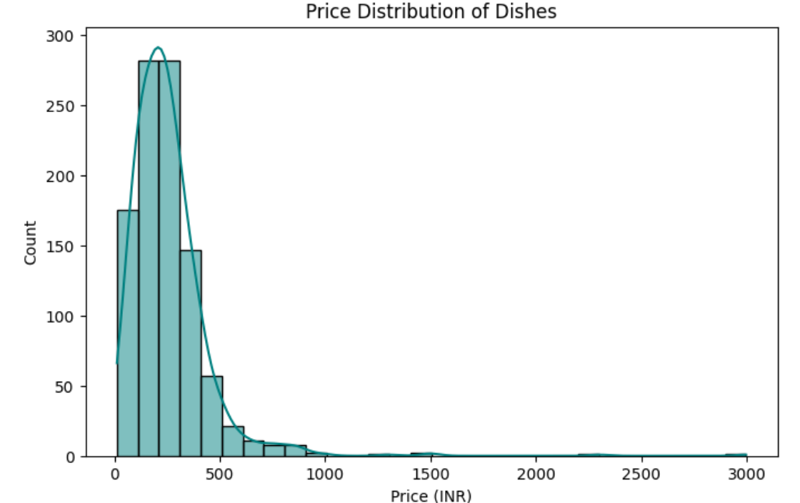
Price Distribution Insights
• Most dishes are moderately priced (₹200–₹300)
• Outliers above ₹2000 represent premium restaurants
• Affordable pricing dominates Swiggy’s listings

Slide 7
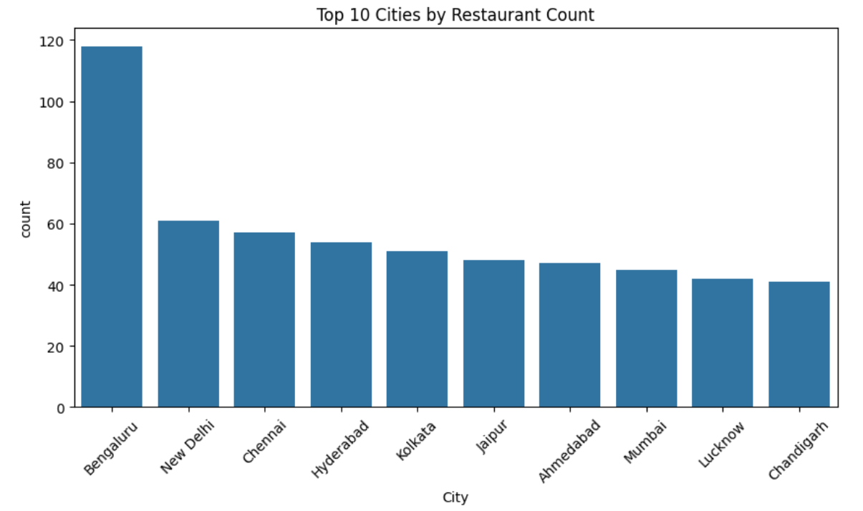
City-Level Insights
• Bengaluru has the highest number of restaurants
• Followed by New Delhi, Hyderabad, and Mumbai
• Indicates Bengaluru as Swiggy’s biggest market hub

Slide 8
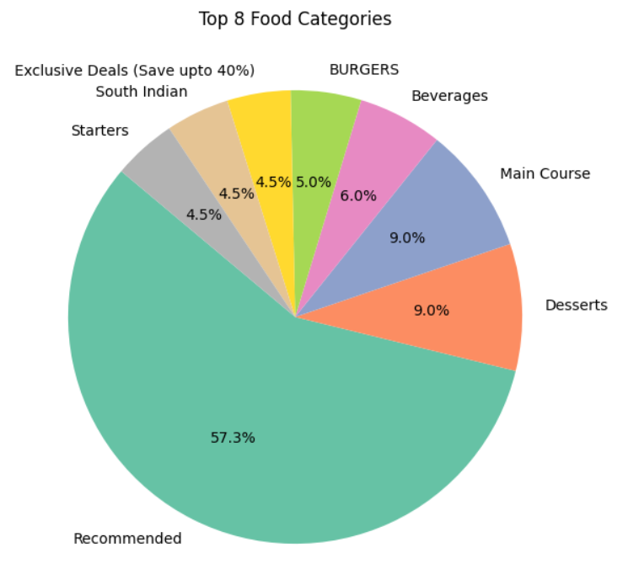
Category Insights
• 'Recommended' is the most common category
• Desserts, Snacks, and Pizzas are also highly represented
• Indicates strong customer preference for these items

Slide 9
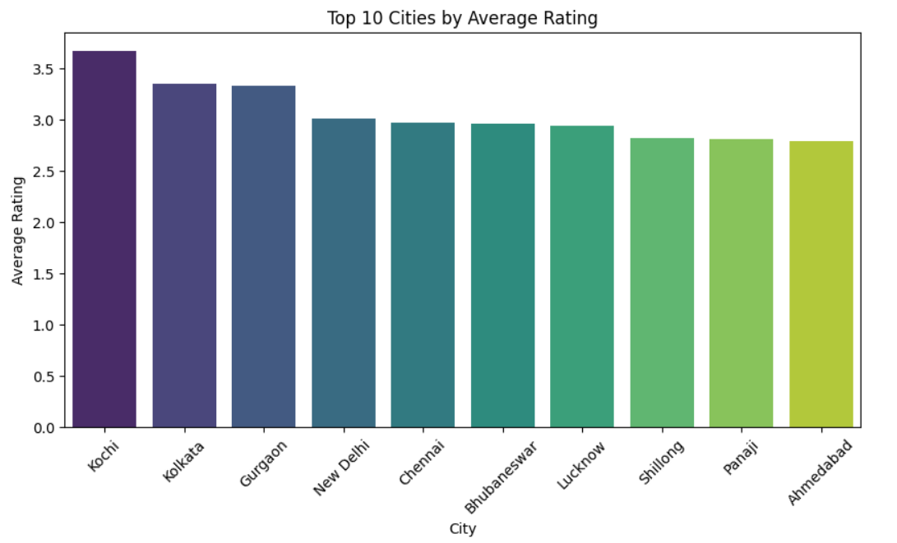
Rating Insights
• Average rating: 2.5 (on a scale of 0–5)
• Top-rated dishes (>4.0) mostly found in premium restaurants
• Desserts and Pizzas dominate high-rated categories

Slide 10
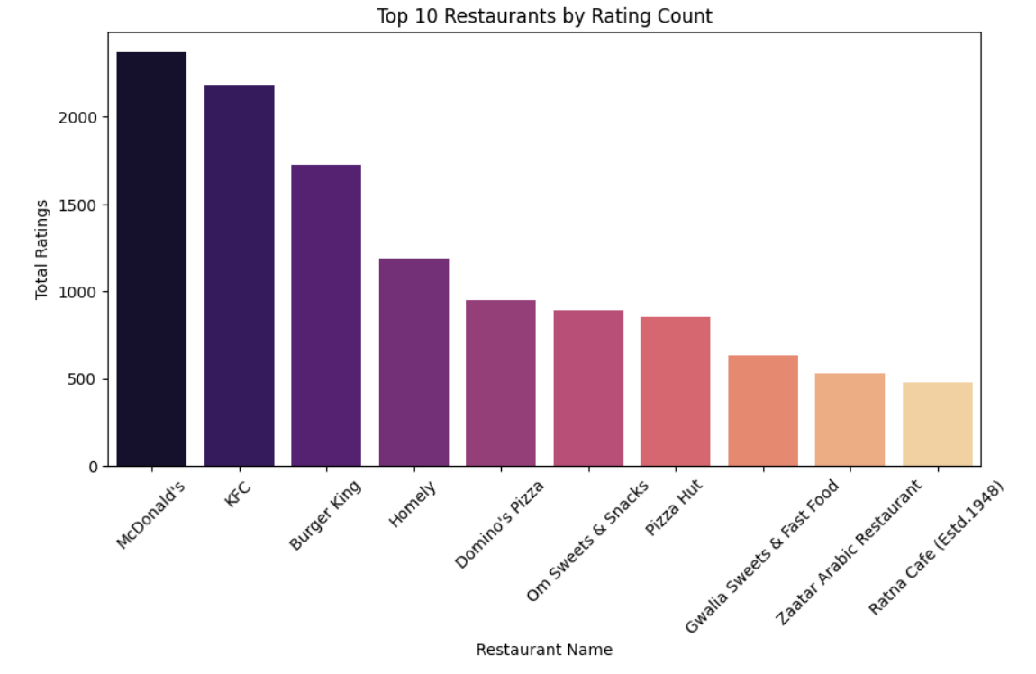
Restaurant Insights
• Fast food chains like Domino’s, Pizza Hut, KFC, and Subway dominate
• Consistent branding and affordable pricing drive high visibility
• Smaller local restaurants appear in niche categories

Slide 11
Visualization Highlights
• Plotted price vs rating distributions
• Compared city-level averages using bar charts
• Used PySpark SQL for grouped aggregations and counts

Slide 12
Key Insights
Salaries vary widely across the dataset, showing diversity in roles and experience levels. 
Average salary is around the mid-level range, with notable outliers at both ends.
Average salary differs by gender, indicating possible pay gaps or differences in job roles. 
Male employees tend to have slightly higher average salaries than female employees.

Slide 13
Recommendations
• Maintain affordable pricing for popular dishes
• Promote desserts and snacks with high ratings
• Strengthen operations in Bengaluru
• Focus on underrepresented cities for market expansion
• Use clustering to group dishes by price and ratings for targeted marketing

Slide 14
Conclusion
• Customers prefer affordable and mid-range dishes
• Bengaluru leads in restaurant count
• Desserts and Pizzas dominate top-rated categories
• Insights can guide pricing, marketing, and city-level strategy

